Slide 1



Slide 2

Digital Eye
Supervised by:
Mr. Rehan Tariq
Group Members:
Abdul Basit (FA17-BCS-086)
Syed Aaqil Abbas (FA17-BCS-059)
Department of Computer Science
COMSATS University Islamabad, Attock Campus

Slide 3
Outline
Introduction
Working flow
Problem statement
Objectives
Methodology
Functional Requirements
Existing app
Modern tools
Benefits
Diagrams
System Screenshots
References
_______________________________

Slide 4

Introduction
It is difficult life for disable people without visual senses.
Life has been so complex for the blind people so, it is very difficult to survive in society for blind people.
In society, there are some persons who could not see the beauty of this universe and living their life so hard.
The blind people are mostly seen asking people for help or in other words, they are always dependent on someone.
We saw lot of people trying to struggle in society with their disabilities.
_______________________________

Slide 5
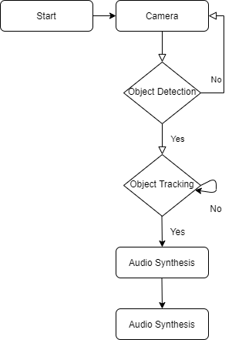
Working Flow
_______________________________

Slide 6
Problem statement
It is difficult for disable persons to survive without vital senses. Life has been so complex and every place turns into mob.
Guardians not able to monitor their respective relatives current location.
The main problem is how we can make life of blind persons easier using today’s technologies.
When we will start working we have following questions in mind,
Q.1 How to trace obstacles through sensors and sending response fast to the person using voice with app?
Q.2 How to track the person from other device?
Q.3 What if there is no light in room?
Q.4 What if blind person what help how he tells his/her guardians?
_______________________________

Slide 7
Objectives
Automated app to detect obstacles using camera sensor.
Making blind persons independent.
Easing and simplifying the life of blind person.
To provide easily trackable environment for the guardians of users.
To provide personal assistant to blind person.
To serve the humanity.
_______________________________

Slide 8
Methodology
Camera is the main sensor in our App. Camera is used as a sensor to analyses the environment.
Camera will check the environment whether the blind person having obstacles in front of him if yes, then the App will notifies the person by speaking using earplugs or speakers.
Map is also used in this App to give two functions,
Used for tracking person from another device
Used to tell the routes of destination to person which is being set.
A piece of software is also given to the guarding to track the blind person.
_______________________________

Slide 9
Functional Requirements
Signup
Login
Object Tracking
Feedback
Tracking Location
_______________________________

Slide 10
Non Functional Requirements
Usability
Ease of use
Performance
Security
Validation
_______________________________

Slide 11
Existing App
Name | Weakness | Digital Eye
Be My Eyes | The app is to be used at your own risk, i.e., you are depending on “helpers” to navigate the world around you. In this one person is bound for you they tell you path with the help of video calling. | In our proposed application, only once you need a person who will made you login to system and open camera, after that blind person can use this application by self.
Blind square | This application is only supported in IOS. It is not free If blind person want to use this app then you buy this app this app is not free. Its price is $39.99. | The main difference between Blind Square and our app is (Free). Our application is free for user.
_______________________________

Slide 12
Development Requirements
Software Requirements dependence:
IDE: Android Studio 3.5
Programming language: Java, XML
Database: MYSQL or Firebase
Tools: PyCharm, Android Studio, JDK
SDK
Google Map APIs
Hardware Requirements dependence:
Smart Mobile Phone: Android
Headphones

Slide 13
Modern tools
Tools | Version | Rationale
Android studio | 4.0.1 | IDE
Python | 3.7.2 | Machine Learning
MySQL | 2018 | DBMS
Adobe Photoshop | CC 2020 | Design Work
MS Word | 2019 | Documentation
MS Power Point | 2019 | Presentation
Technology | Version | Rationale
XML, Java | 6.0 | Programming language
OpenCV | latest | Library for object tracking
Headphones | Any | To receive the voice
_______________________________

Slide 14
Benefits
First of all, the benefit of this app is that we will able to help the humanities.
The proposed application will helps blinds to live their life with colors.
It will helps to rehabilitated blind to become a active part of society.
The proposed application will improve daily activities and make blind community independent and boost their confidence.
We proposed a cost effective solution to the community as no other external gadget required for this application.
(White cane, Glasses these are the tools which are used by every blind person and have no connection with our proposed application.)
_______________________________

Slide 15
Diagrams
Use Case Diagram
Use Case for Blind
Use Case for Relative
Design and Architecture
System Architecture
Process Diagram
DFDs
DFD Level 0
DFD Level 1
Sequence Diagram
Class Diagram
ERD
_______________________________

Slide 16
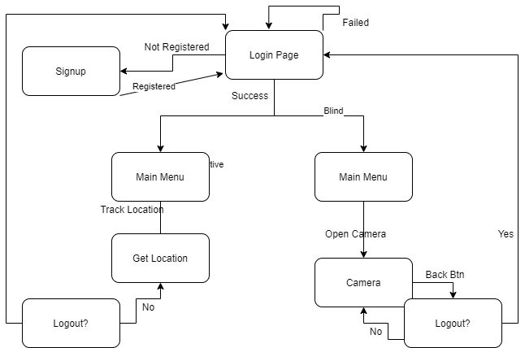
System Architecture
_______________________________

Slide 17
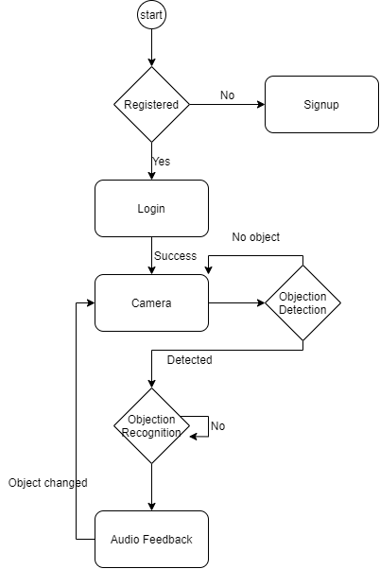
Process Diagram
_______________________________

Slide 18
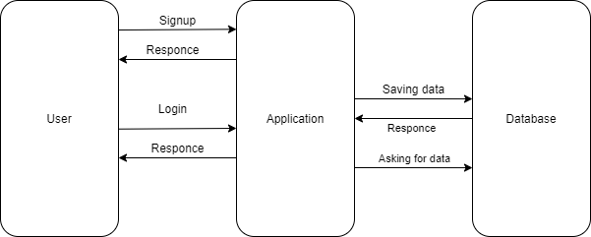
DFDs
DFD Level 0
_______________________________

Slide 19
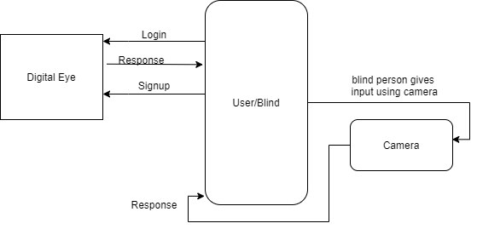
DFDs
DFD Level 1 for Blind
_______________________________

Slide 20

DFDs
DFD Level 1 for Relatives
_______________________________

Slide 21
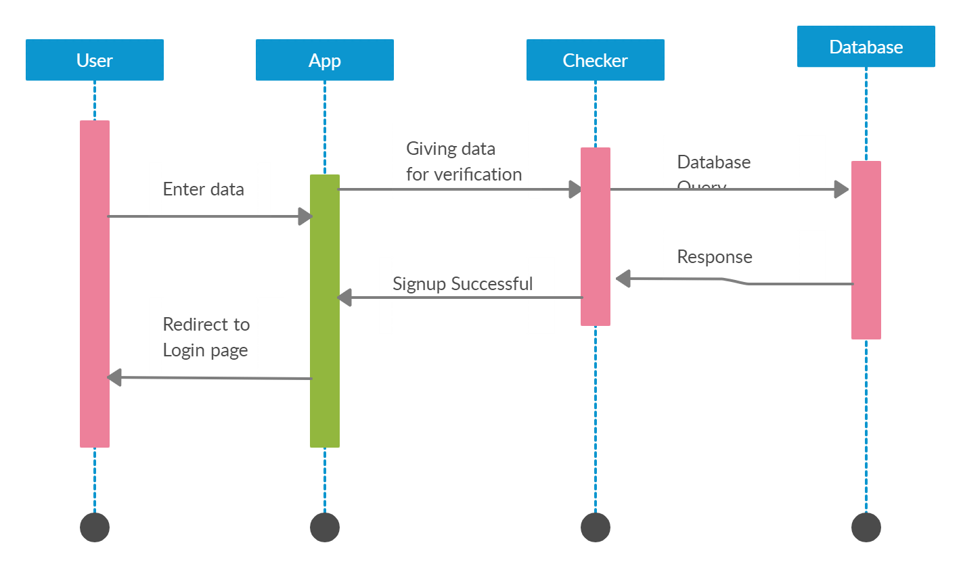
Sequence Diagrams
Sequence Diagram for Signup
_______________________________

Slide 22
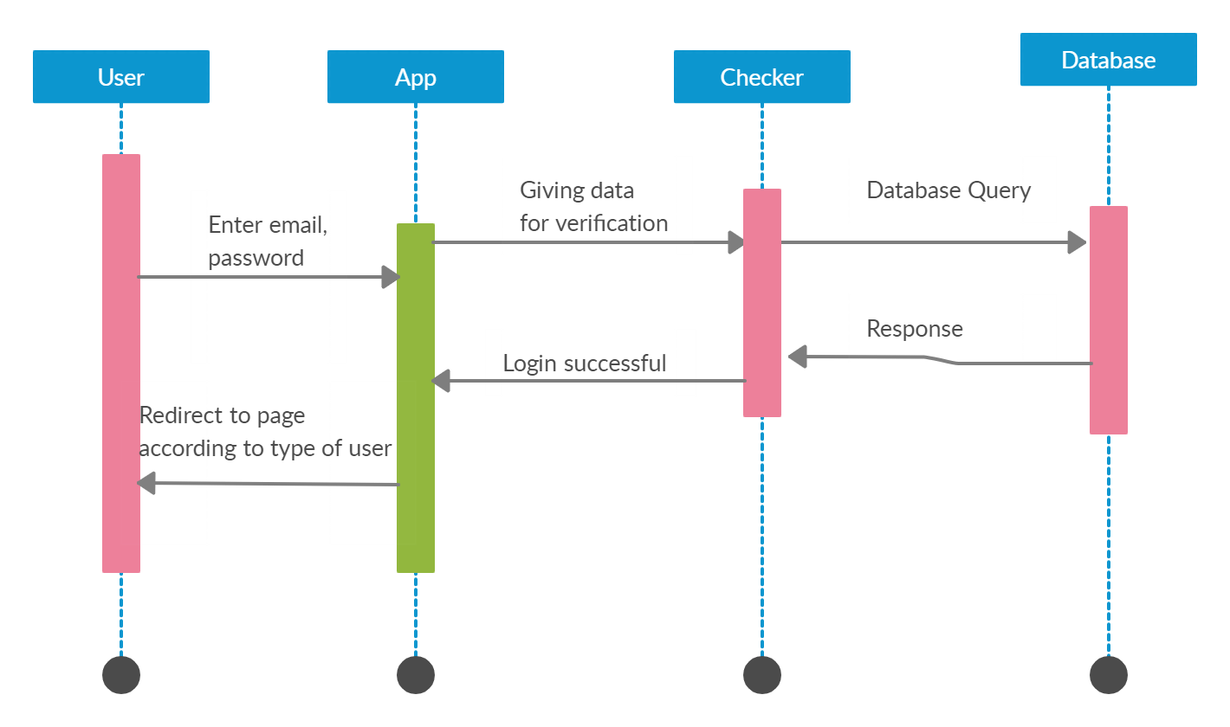
Sequence Diagrams
Sequence Diagram for Login
_______________________________

Slide 23
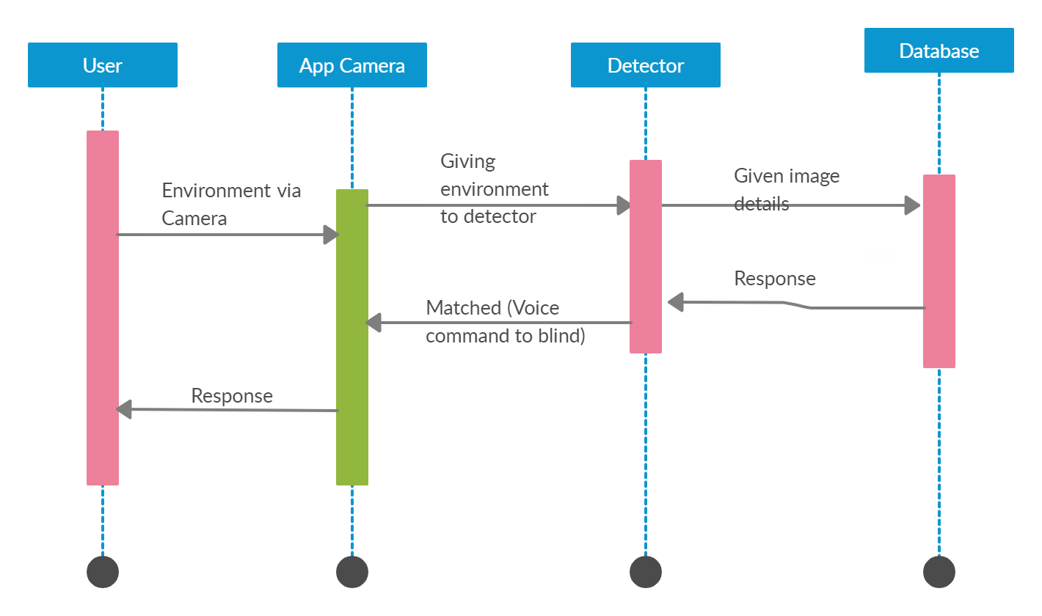
Sequence Diagrams
Sequence Diagram for Object Tracking and Recognition
_______________________________

Slide 24
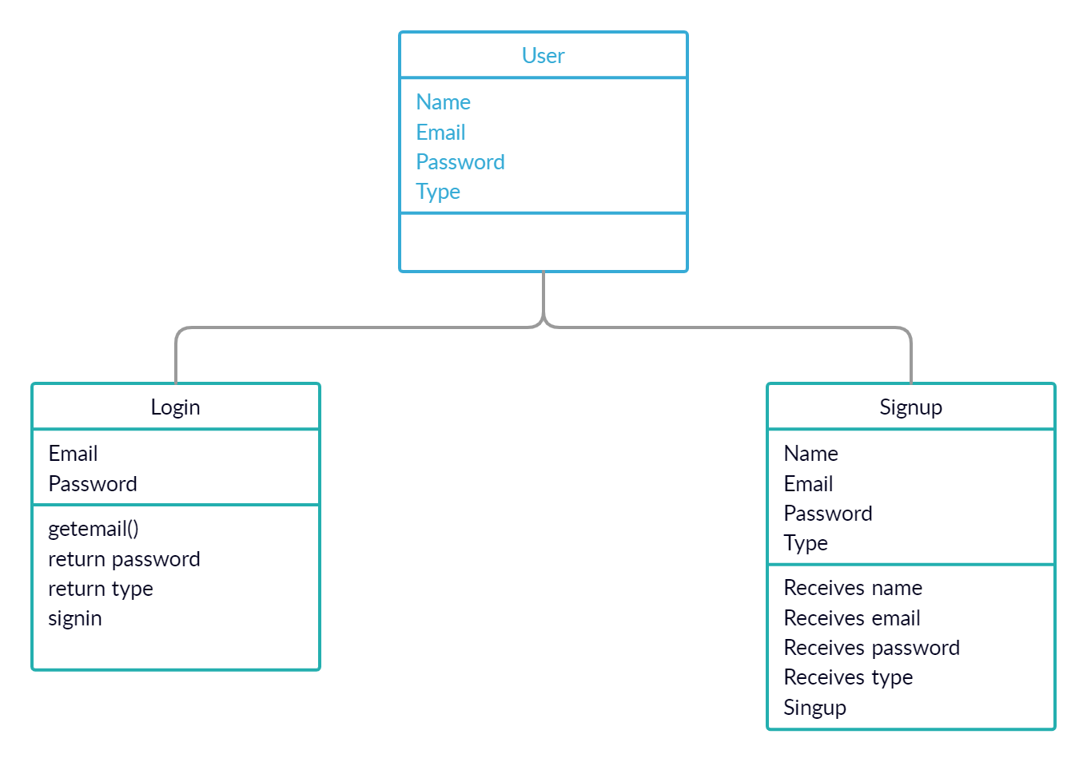
Class Diagrams
_______________________________

Slide 25
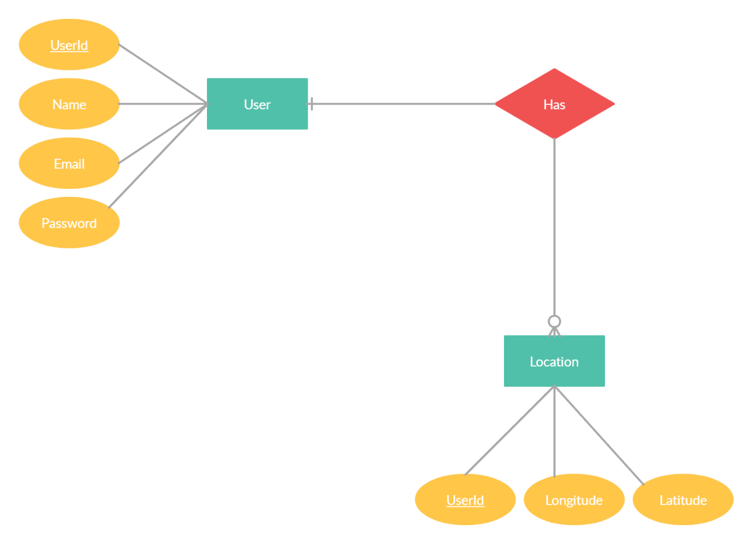
ERD
_______________________________

Slide 26

System Screenshots
Application Icon
_______________________________

Slide 27

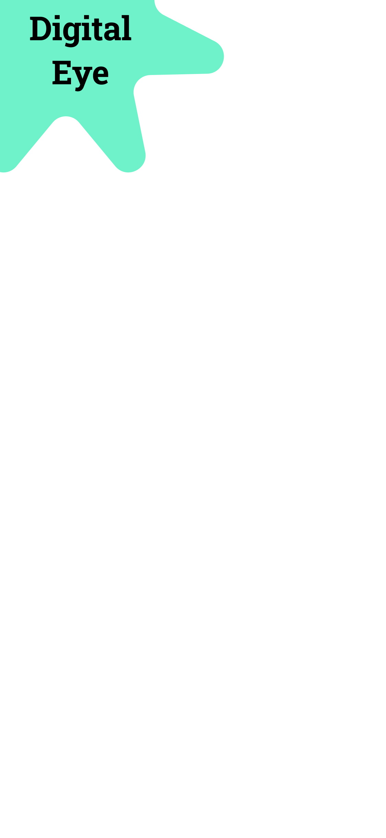
System Screenshots
Splash Screen
_______________________________

Slide 28
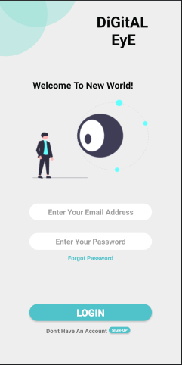
System Screenshots
SS for Login
_______________________________

Slide 29
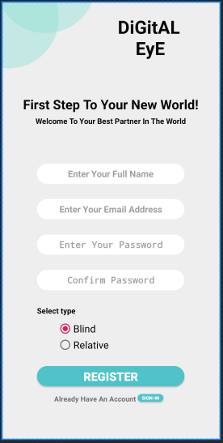
System Screenshots
SS for Signup
_______________________________

Slide 30
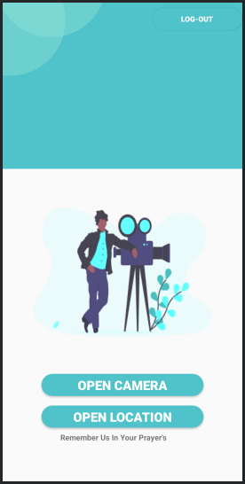
System Screenshots
SS for Blind’s Home page
_______________________________

Slide 31
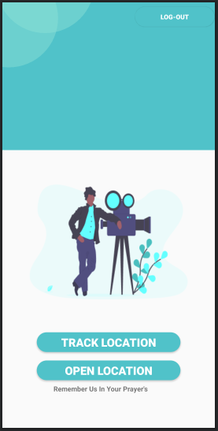
System Screenshots
SS for Relative’s Home page
_______________________________

Slide 32
References
https://stackoverflow.com/questions/38072334/how-to-start-machine-learning-with-python-programming
https://stackoverflow.com/questions/7256700/object-tracking-in-python
https://en.wikipedia.org/wiki/Android_software_development
J.A.Larson (2003,Oct),VoiceXML:Introduction to Developing Speech Applications.
_______________________________

